Slide 1
CAR
By Abhijit Singh and tom le

Slide 2
Technologies

Slide 3
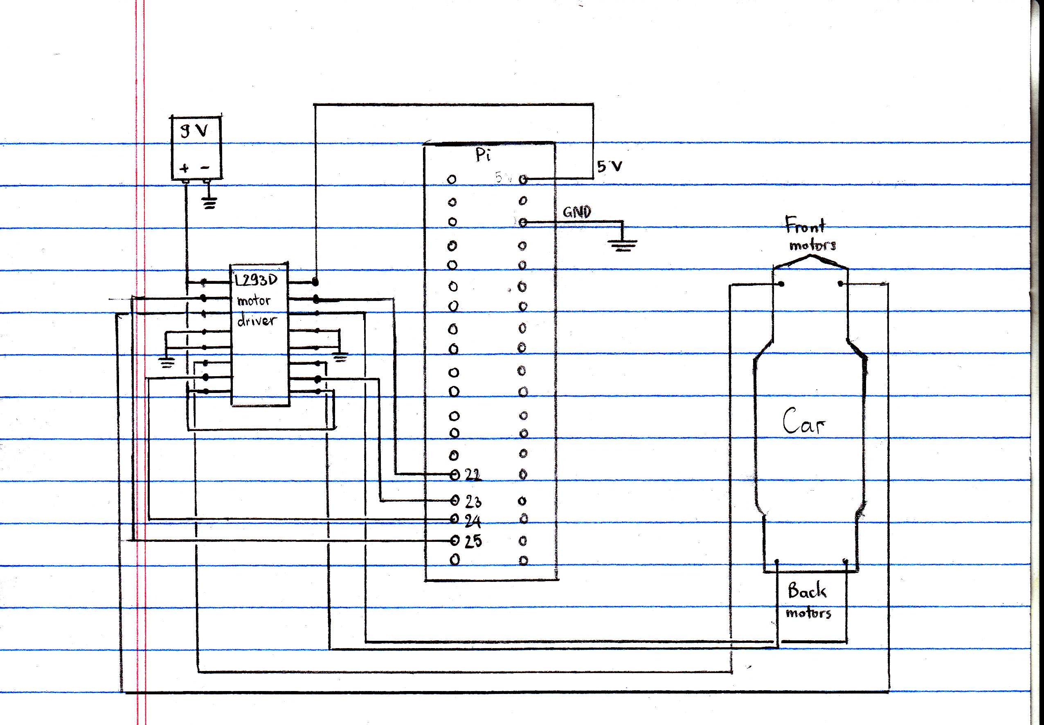
Circuit

Slide 4
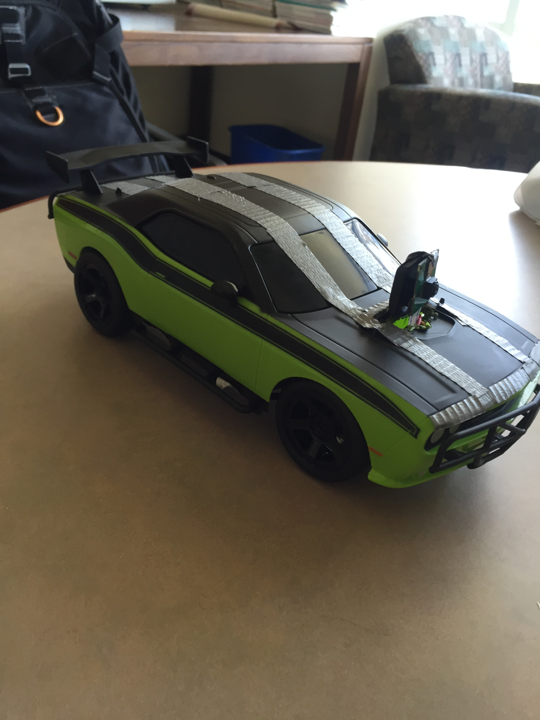
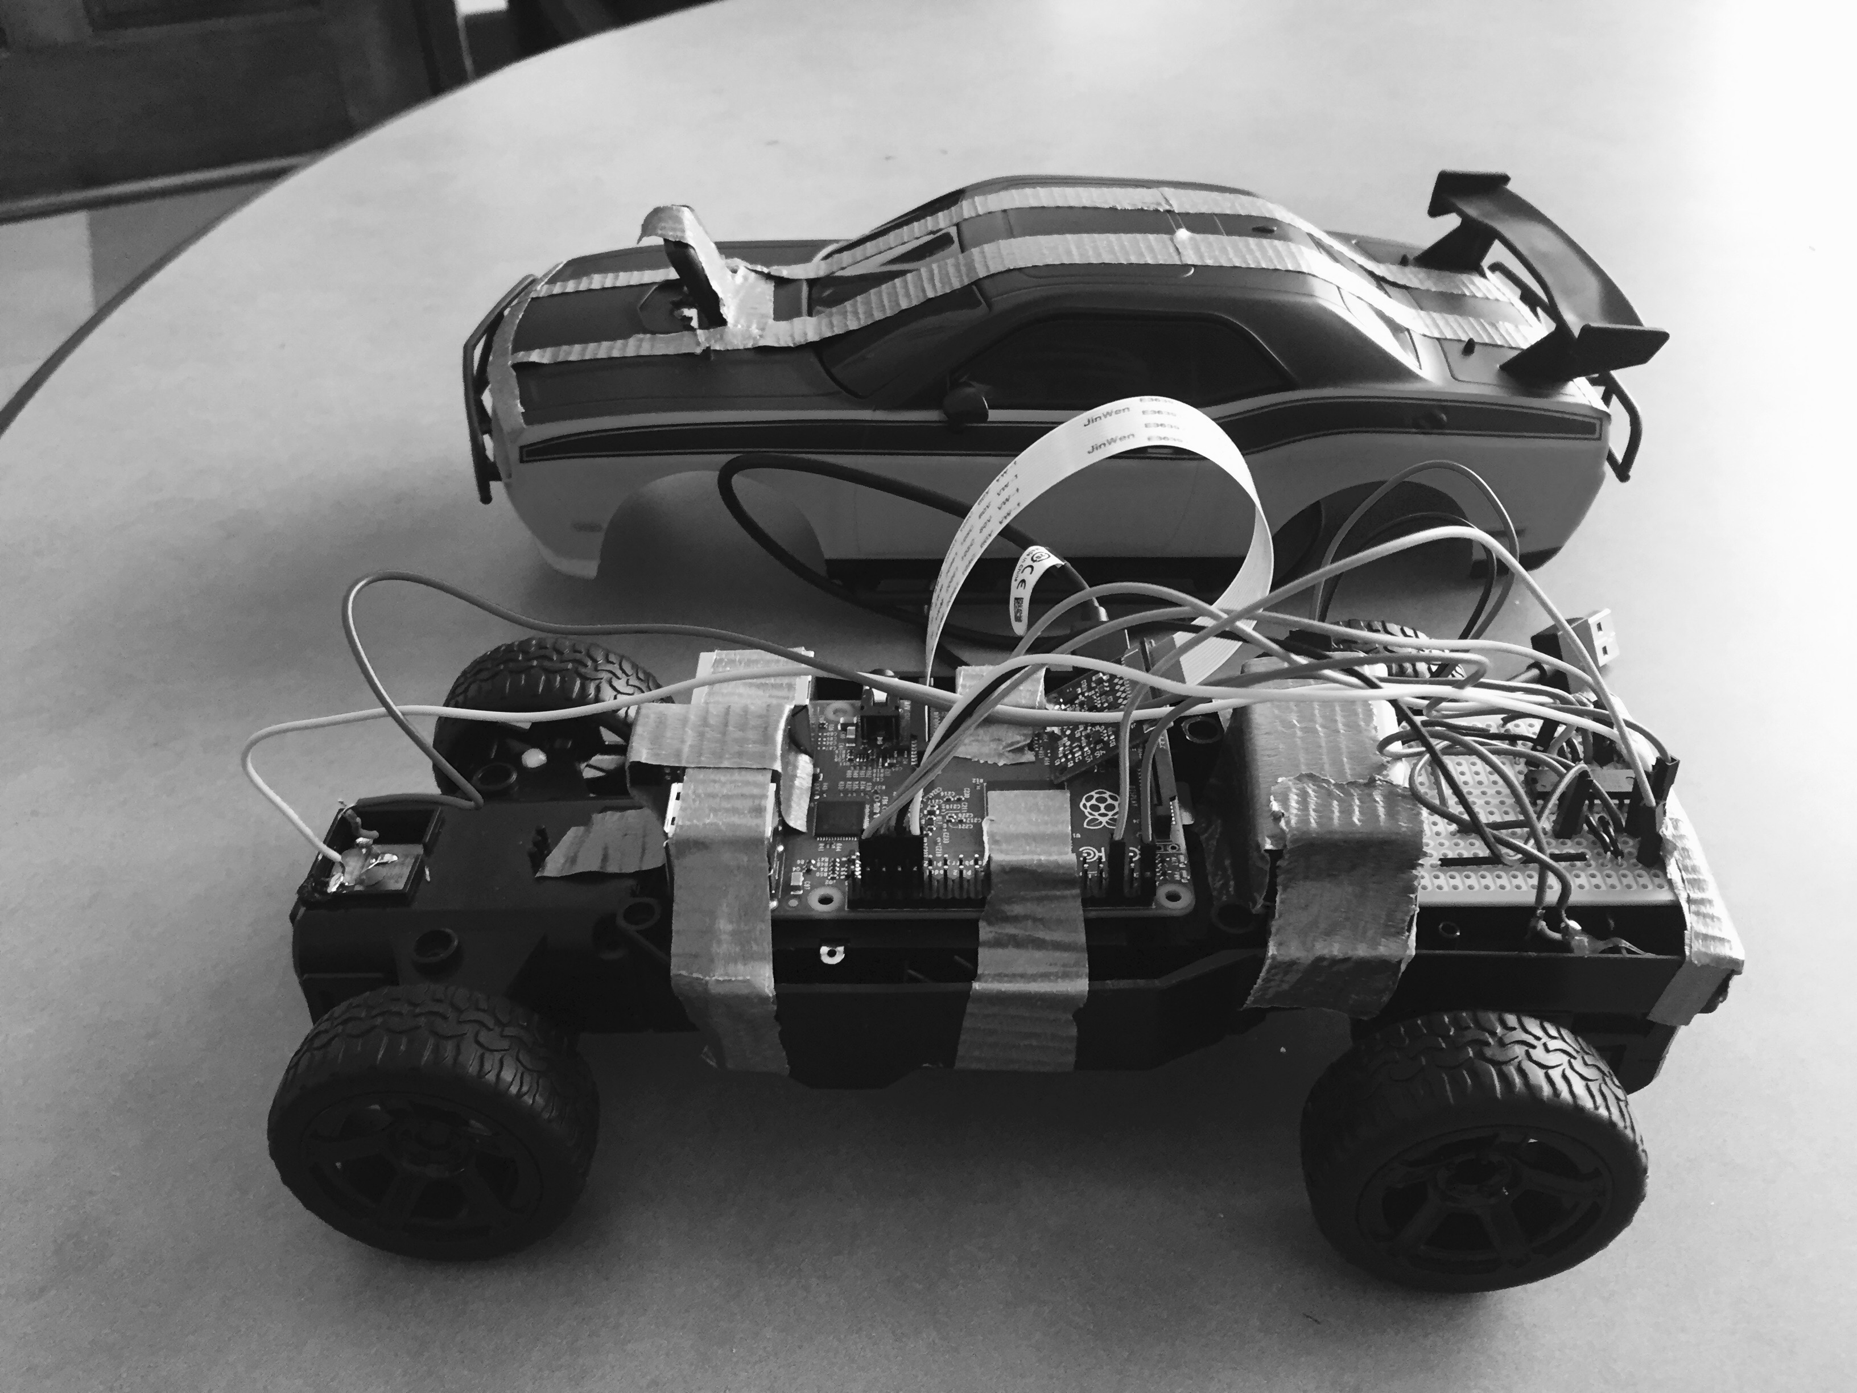
Challenges
Hardware integration
Circuit
Weight:power
Clark wifi (dynamic ip)

Slide 5
Demo

